Slide 1
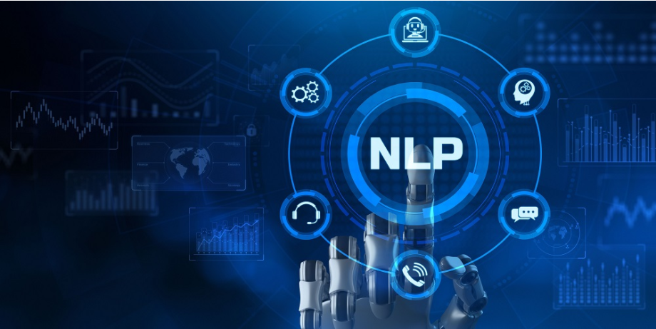

Natural Language Processing
ITC-6010 Spring 2021
Topic Modeling
Instructor: Dr. Lazaros Polymenakos
Presented by:
Thodoris Diamantopoulos | Dimitra Kouvara | Dimitris Salmatanis

Slide 2
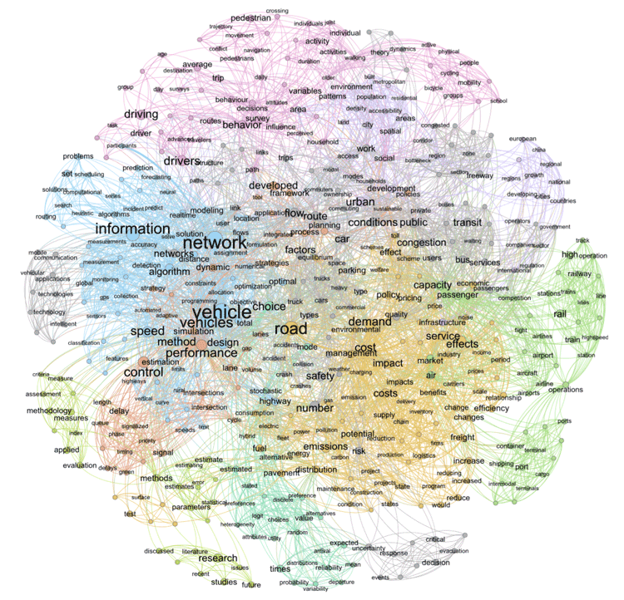

Topic Modeling
Annotating documents according to topics
Discovering hidden topical patterns
Organizing, searching and summarizing textual information

Slide 3


Dataset
No. of tweets | 41122
No. of links | 9641
No. retweets | 114
No. mentions | 40812
No. of hashtags | 7171
No. of picture URLs | 3379
No. of tokens | 485968
favorites
mentions
content
Data
Source
hashtags
link
Exploratory analysis
date
retweets
geo
ID
Data Provider
Trump Tweets

Slide 4
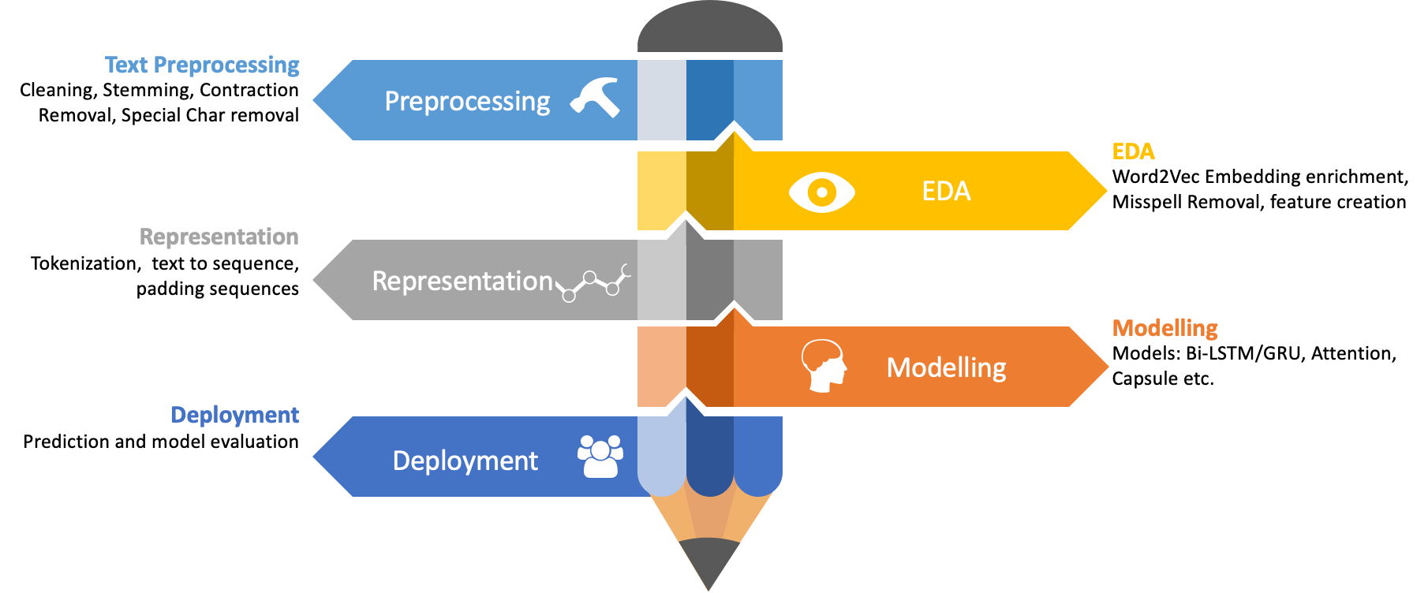
Timeline

Slide 5
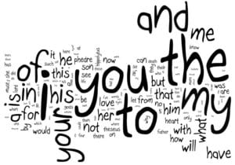


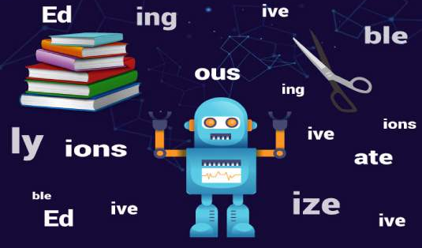
Text Preprocessing
Removing
mentions
punctuations
Lowercase
stopwords
newline
double spacing
links
Lemmatize & Stemming
Removing unnecessary columns

Slide 6



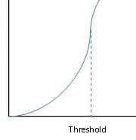
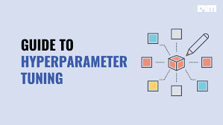
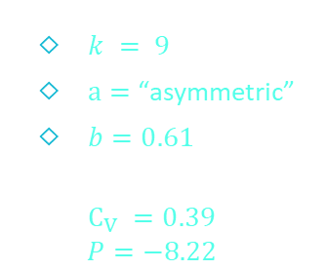
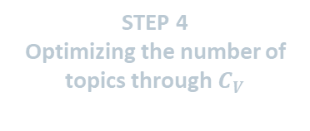
LDA model
Interpretability Optimization
STEP 4
Optimizing the number of topics through $C_{V}$
STEP 1
Identifying phrases through n-grams
STEP 5
Adjusting LDA hyperparameters
$k = 9$
$a=$ “asymmetric”
$b=0.61$
$$C_{V} =0.39$$
$$P=−8.22$$
STEP 2
Filtering noun-type structures
STEP 3
Choosing PMI threshold

Slide 7
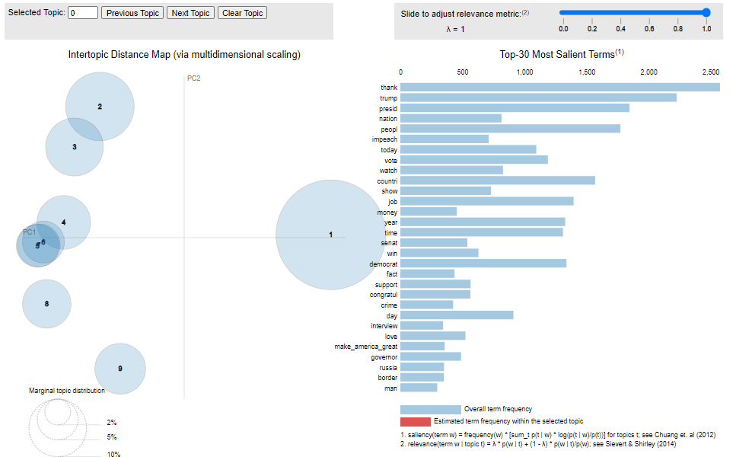
LDA model
Hyperparameter Tuning

Slide 8
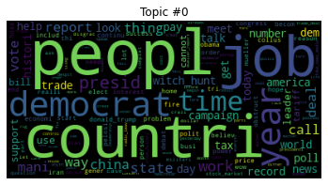
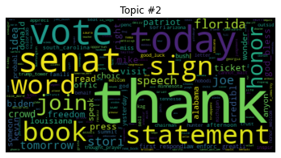
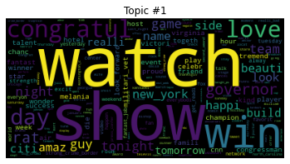
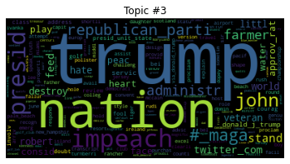

Slide 9
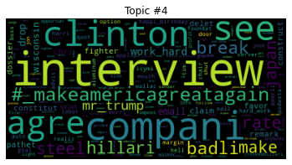
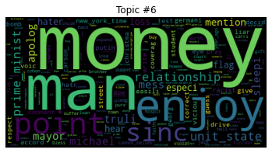
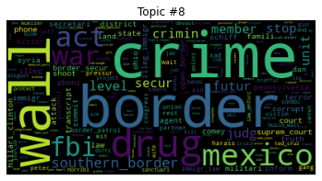
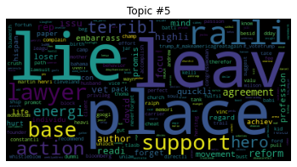
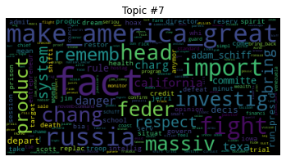

Slide 10
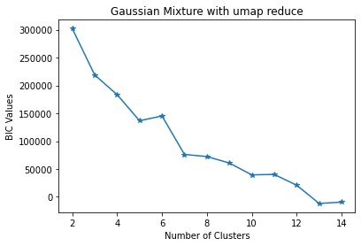
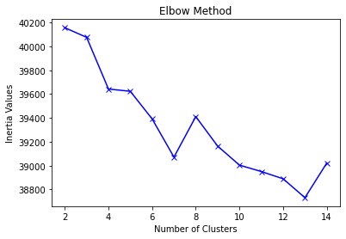
K-means Clustering
Optimal Number of Clusters

Slide 11
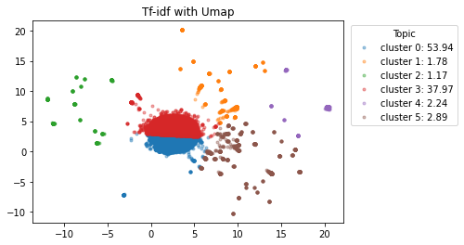
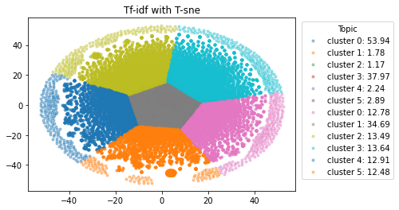
K-means Clustering
Visualizing Topics in Clusters
Silhouette score with TF-IDF UMAP
0.4062511
Silhouette score with TF-IDF T-SNE
0.32096392

Slide 12
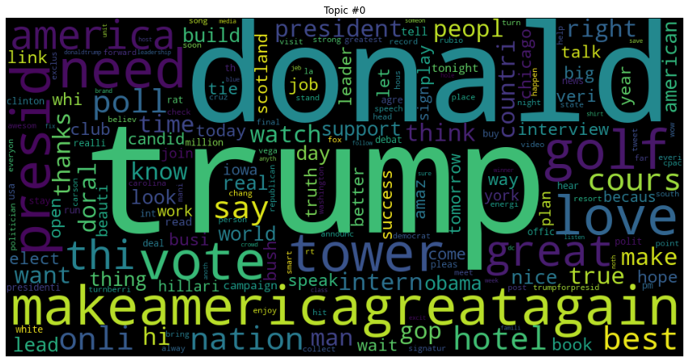
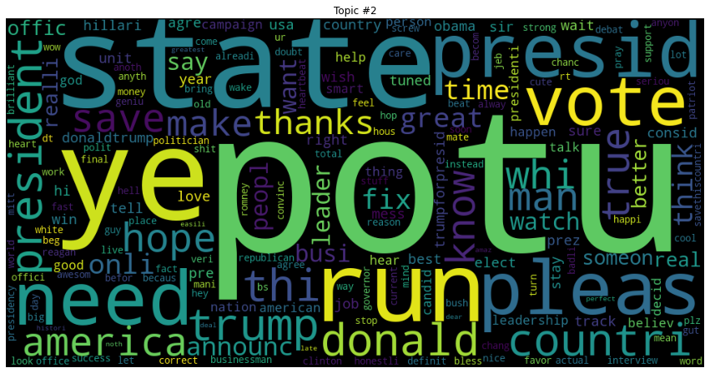
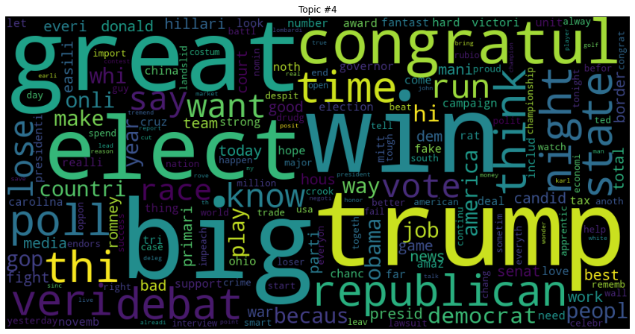
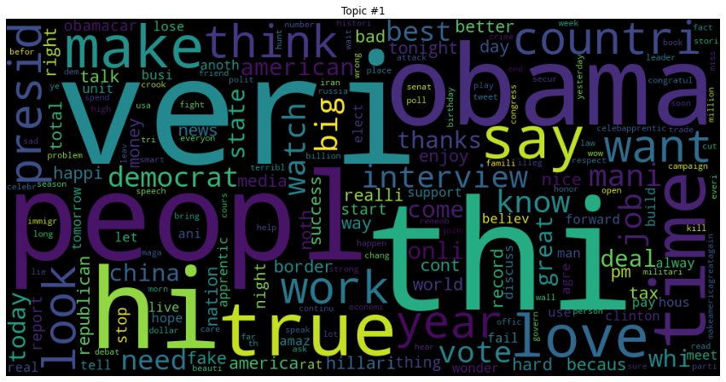
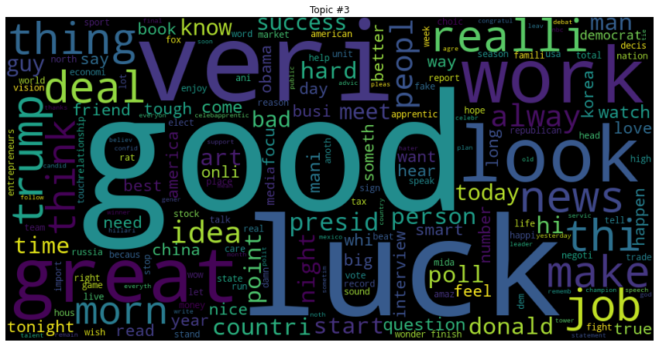
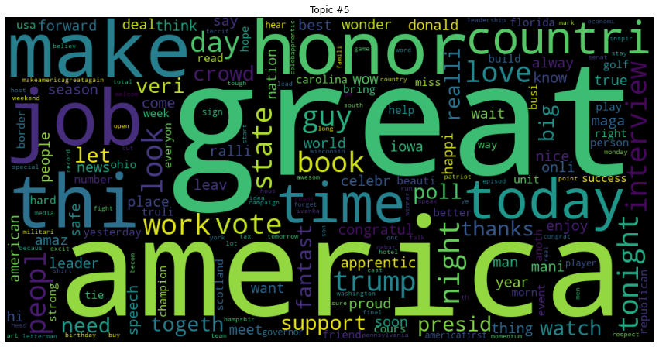
K-means Clustering
Word Cloud - Topics Representation

Slide 13
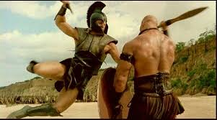
Conclusions
Comparison between the two models
LDA vs. K-means
Bag-of-words
+ Documents are characterized by one or more topics
- More execution time [3543.48 s]
- Hard to determine hyperparameters
Word Embeddings
+ Less execution time [53.17 s]
- Information loss due to hard clustering
- Dimensionality reduction (trade off accuracy for speed)
LDA
K-means
More sentiment topics

Slide 14
Future Implementation
04
03
Selection of another dataset
Implement more models (PLDA, PAM)
02
Optimized Topic Modelling
01
Alternative resources (Google Collab)
05
Hyperparameter tuning for LDA model

Slide 15
References
(n.d.). Retrieved from kaggle: https://www.kaggle.com/austinreese/trump-tweets
David M. Blei, A. Y. (2003). Latent Dirichlet Allocation.
Lavorini, V. (2018, 11 21). Retrieved from towardsdatascience: https://towardsdatascience.com/gaussian-mixture-model-clusterization-how-to-select-the-number-of-components-clusters-553bef45f6e4
Wei Li, A. M. (n.d.). Pachinko Allocation:DAG-Structured Mixture Models of Topic Correlations.
Yi Wang, H. B.-Y. (n.d.). PLDA: Parallel Latent Dirichlet Allocation for Large-scale Applications.

Slide 16
Thank you for your attention

